Slide 1
Cellular Cryptography
Honors Option for NSSA 245
Alex Beaver

Slide 2
Topics
What drove mobile network design?
How does authentication/ authorization happen?
How does transport-layer security work?

Slide 3
Constraints of a Mobile Network
Radio roaming
Access method and core are independent
Billing and QoS

Slide 4
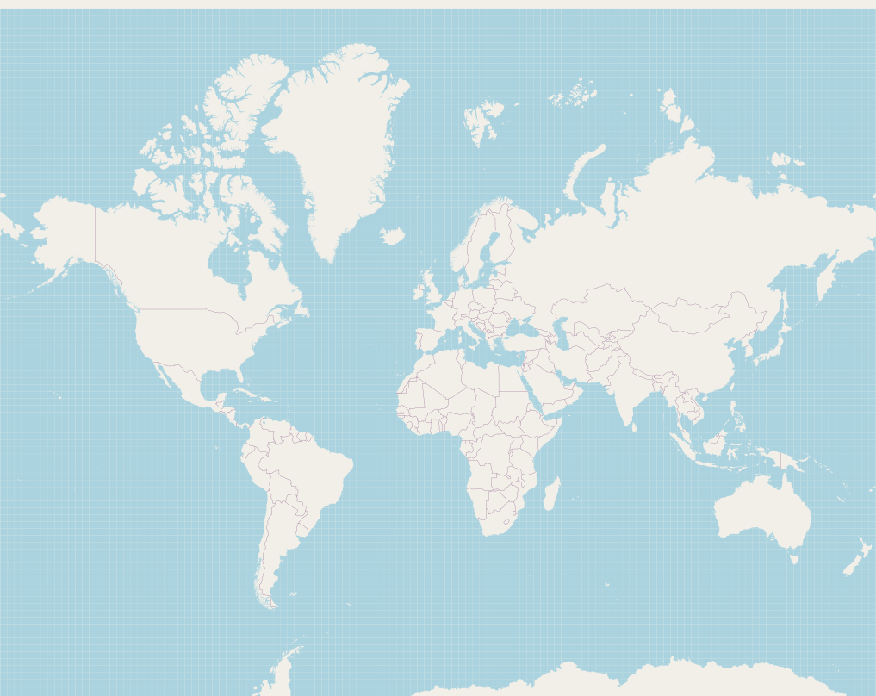
© OpenStreetMap Contributors
Structure

Slide 5
© OpenStreetMap Contributors
Structure

Slide 6
SIM Card (SIM)
User Endpoint (UE)
Structure
Base Station/Radio (eNB/ng-eNB)
Mobility Management Engine (MME)
Packet Core
Home Subscriber Server (HSS)

Slide 7
SIM Card (SIM)
Chip for Network Authentication
Inside of the User Endpoint
Cryptographic Operations, Data Storage
Data about the subscriber
TPM to store keys
Duplicate of data on HSS

Slide 8
SIM Card (SIM)
User Endpoint (UE)
Base Station/Radio (eNB/ng-eNB)
Mobility Management Engine (MME)
Packet Core
Home Subscriber Server (HSS)

Slide 9
User Endpoint (UE)
Device that a user interacts with
Phone, Laptop, Car, Vending Machine
Contains the SIM Card
Radios to connect to the network

Slide 10
SIM Card (SIM)
User Endpoint (UE)
Base Station/Radio (eNB/ng-eNB)
Mobility Management Engine (MME)
Packet Core
Home Subscriber Server (HSS)

Slide 11
Mobility Management Engine (MME)
Per Region
Part of the EPC
Owned by Serving Network
Manages connection to the network

Slide 12
SIM Card (SIM)
User Endpoint (UE)
Base Station/Radio (eNB/ng-eNB)
Mobility Management Engine (MME)
Packet Core
Home Subscriber Server (HSS)

Slide 13
Home Subscriber Server (HSS)
Part of Packet Core
Owned by home carrier
Stores data about customers and SIM cards
Manages authentication, QoS, Billing, etc.

Slide 14
SIM Card (SIM)
User Endpoint (UE)
AAA
Base Station/Radio (eNB/ng-eNB)
Mobility Management Engine (MME)
Packet Core
Home Subscriber Server (HSS)

Slide 15
© OpenStreetMap Contributors
AAA

Slide 16
Authentication vs Authorization
Authentication
Authorization
Who is a SIM card assigned to?
Is this a legitimate device?
Is this device on a legitimate network?
Is a user allowed to roam on this network?
Can a user access certain carrier resources?
What QoS should this device expect?
AAA

Slide 17
Authentication and Authorization
Challenge/Response
SIM/UE initiates a connection to MME
MME forwards SIM data to HSS
HSS gives a random value to the SIM, and tells MME what to expect as output

Slide 18
Keys
Root is stored on HSS and derived on SIM
Derive down
Limit scope
Add parameter at each step, cannot reverse upwards
HSS is a relay

Slide 19
Keys
K is stored on SIM
Cipher Key, Integrity Key on HSS
Derivation is Carrier-Specific
K_{ASME} is per SN/SEQ, on MME
K_{eNB} adds COUNT, at eNodeB

Slide 20
Minimize Computation
2
2
2
2
A
B
A
B
A
B

Slide 21
Minimize Computation
Change eNodeB
K
CK, IK
SEQ
K_{ASME}
K_{eNB}
2
2
2
2
A
B
A
B
A
B

Slide 22
Minimize Computation
Change MME
K
CK, IK
SEQ
K_{ASME}
K_{eNB}
2
2
2
2
A
B
A
B
A
B

Slide 23
Minimize Computation
Change SN
K
CK, IK
SEQ
K_{ASME}
K_{eNB}
2
2
2
2
A
B
A
B
A
B

Slide 24
Opportunities for Failure
Incorrect MAC
SEQ Synchronization Failure
Incorrect AV type
Invalid Authentication (XRES ≠ RES)
Retransmission of (RAND, AUTN)

Slide 25
Evolution Over Time
5G: Authenticate with Home Network
4G (LTE): Serving-Network-Specific Keys
3G (UMTS/CDMA2000): Mutual Authentication
2G (GSM/GPRS): Phone Authenticated by Network

Slide 26
Downgrade Attack
Broadcast
2G at super strong signal
5G: Authenticate with Home Network
4G (LTE): Serving-Network-Specific Keys
3G (UMTS/CDMA2000): Mutual Authentication
2G (GSM/GPRS): Phone Authenticated by Network

Slide 27
Network Components

Slide 28
Carrier or Private Services
Serving Network
Home Network
SGW
PGW
Data
Internet
Radio
Base Station
Control
MME
HSS

Slide 29
Strata
Access Stratum
Non-Access Stratum
Layer 2
Between UE and Base Station
Layer 3
Between UE and MME

Slide 30
AS
K_{RRCint} | COUNT | BEARER | Direction
128 | 32 | 5 | 1
Radio Resource Control (RRC) Protocol for signaling
Some unencrypted comm before encrypted
Packet Data Convergence Protocol for RRC & User Data

Slide 31
NAS
K_{RRCint} | COUNT | BEARER | Direction
128 | 32 | 5 | 1
All communication is integrity checked
After establishing algorithm, all communication encrypted
Key derived from HSS
IMEI always secret

Slide 32
Algorithm-Independent

Slide 34
Graveyard

Slide 35
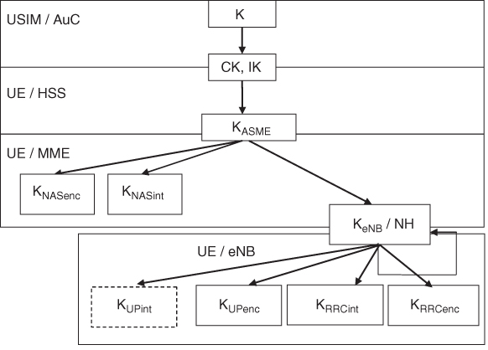
Keys
©2010 3GPP™

Slide 36
Attach Request
PLMN Identity
→ MCC
→ MNC
→ Cell ID

Slide 37
AUTH INFO REQ
IMSI
Serving Network
Establishes
A device is legitimate
The serving network is allowed
EPS AV

Slide 38
AV Authentication Vector
Data that is used to authenticate
Contains
IMSI
Local Key (K_{ASME})
RAND
SEQ (Sequence)

Slide 39
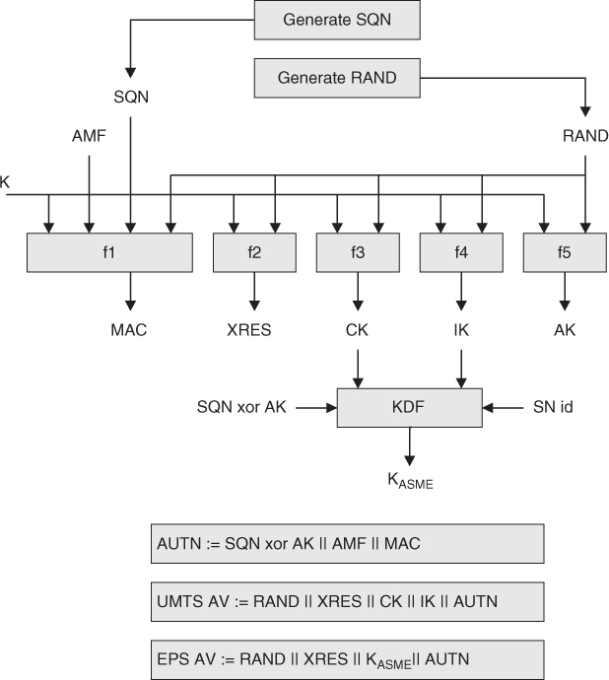
©2009 3GPP™

Slide 40
AUTH INFO Answer
Random Number (RAND)
Expected Response (XRES)
Authentication Vector (AUTN)
EPS AV

Slide 41
AUTH Req
Random Number (RAND)
Authentication Vector (AUTN)

Slide 42
AUTH Req
Random Number (RAND)
Authentication Vector (AUTN)
Verify AUTN
Compute RES
Compute CK and IK
Cipher Key and Integrity Key

Slide 43
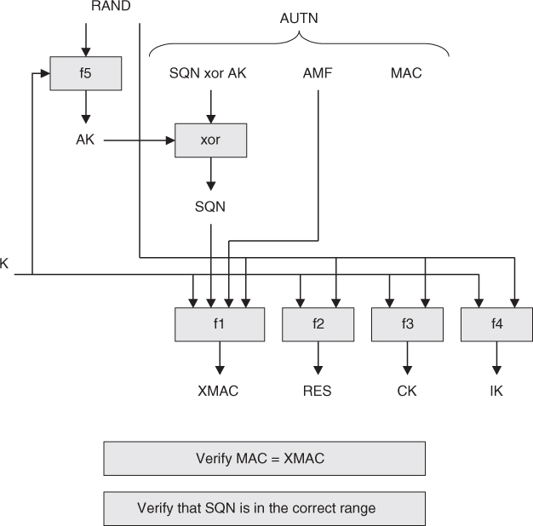
©2009 3GPP™

Slide 44
RES
Compute K_{ASME}

Slide 45
RES
Compare Expected RES (XRES) and RES

Slide 46
Sequence (SQN)
Radios are unreliable
No SQN can be used twice
Once AUTN has been verified, will not accept same SQN with different AUTN
Must allow for out-of-order
Reject on time elapsed or large gap

